Slide 1
Country Report
The GLOBE Program Philippines
Rod Allan A. de Lara
Joan Bilasano Callope
Picture for attention only
Implemented through the Philippine Science High School System

Slide 2
What we said we will do (2018, Vietnam)
Shift in Pivot, focusing on BHNHS, the country’s largest high school, as advocate of the GLOBE program in Quezon City, and NCR
To update content of GLOBE Philippines Webpage, to serve as source of information and interest among teachers
To focus GLOBE Teacher Training on Data Use, Entry, Retrieval, and Visualisation
To strengthen network thru social media communication with other GLOBE AP countries

Slide 3
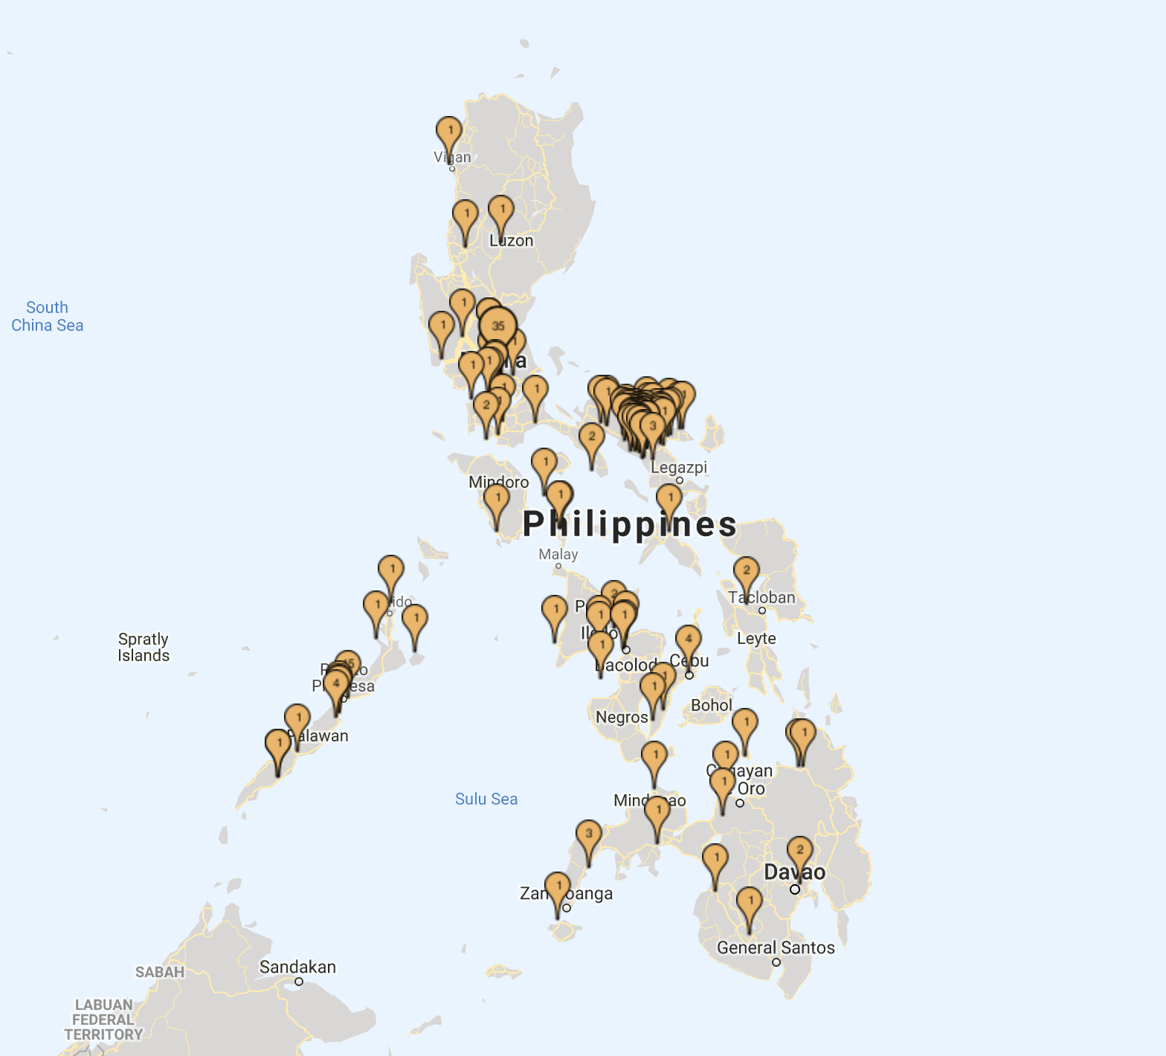
At a Glance
265 Schools
536 Fully Trained GLOBE Teachers
4 Masters Trainers
782 Untrained GLOBE Observers
Data Reporting Activity
Year 2018 – 78 Schools and 223 teachers have reported 1,167 Observations

Slide 4
Cooperating Organizations
The Philippine Science High School System
Batasan Hills National High School
Office of the City Mayor of Quezon City
Quezon City Community Foundation Science Inc.
Department of Education Division of City Schools, Quezon City
Department of Education Division of City Schools, Puerto Princesa City, Palawan
Department of Education Division of Camarines Sur
US Embassy Manila

Slide 5
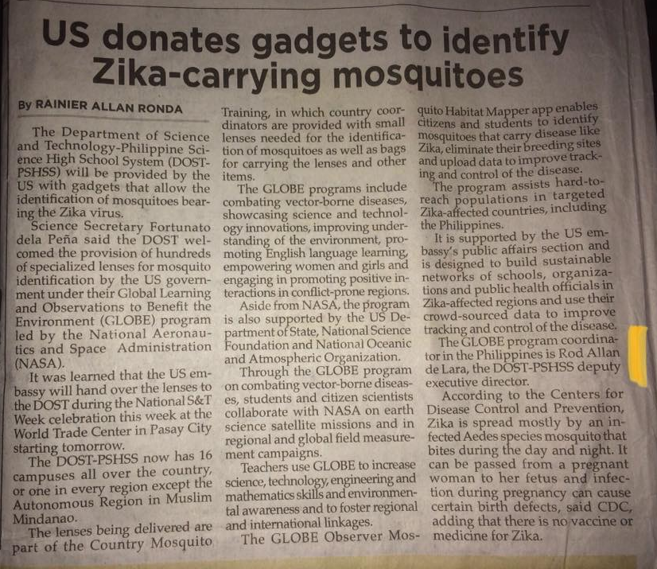
In the News! (The Philippine Star, July 16, 2018)
“Flat Earth Society says… It has members
all around the GLOBE”
- Ron Burgundy

Slide 6
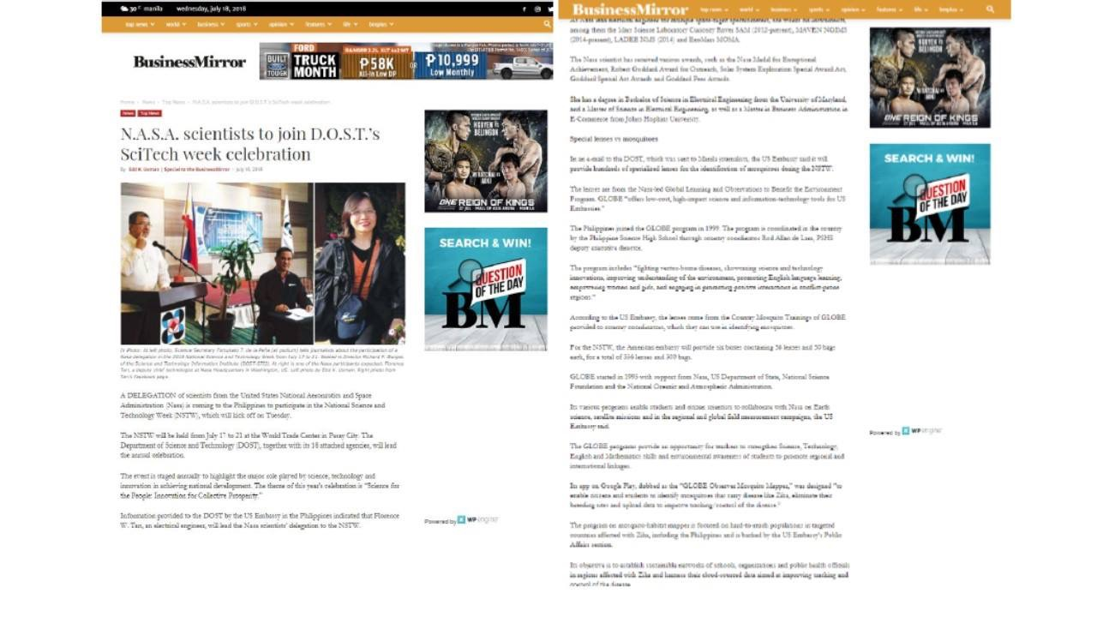
In the News, Business Mirror (July 18, 2018)

Slide 7
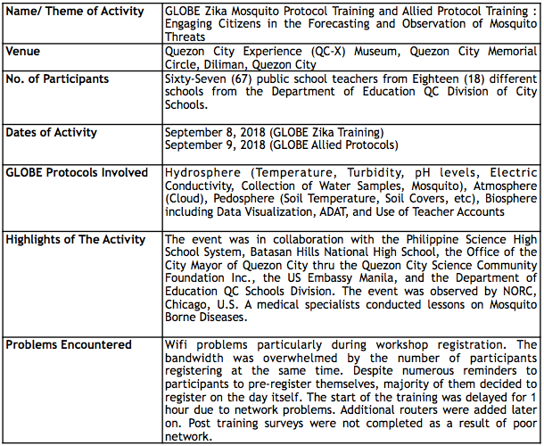
BHNHS, Quezon City

Slide 8
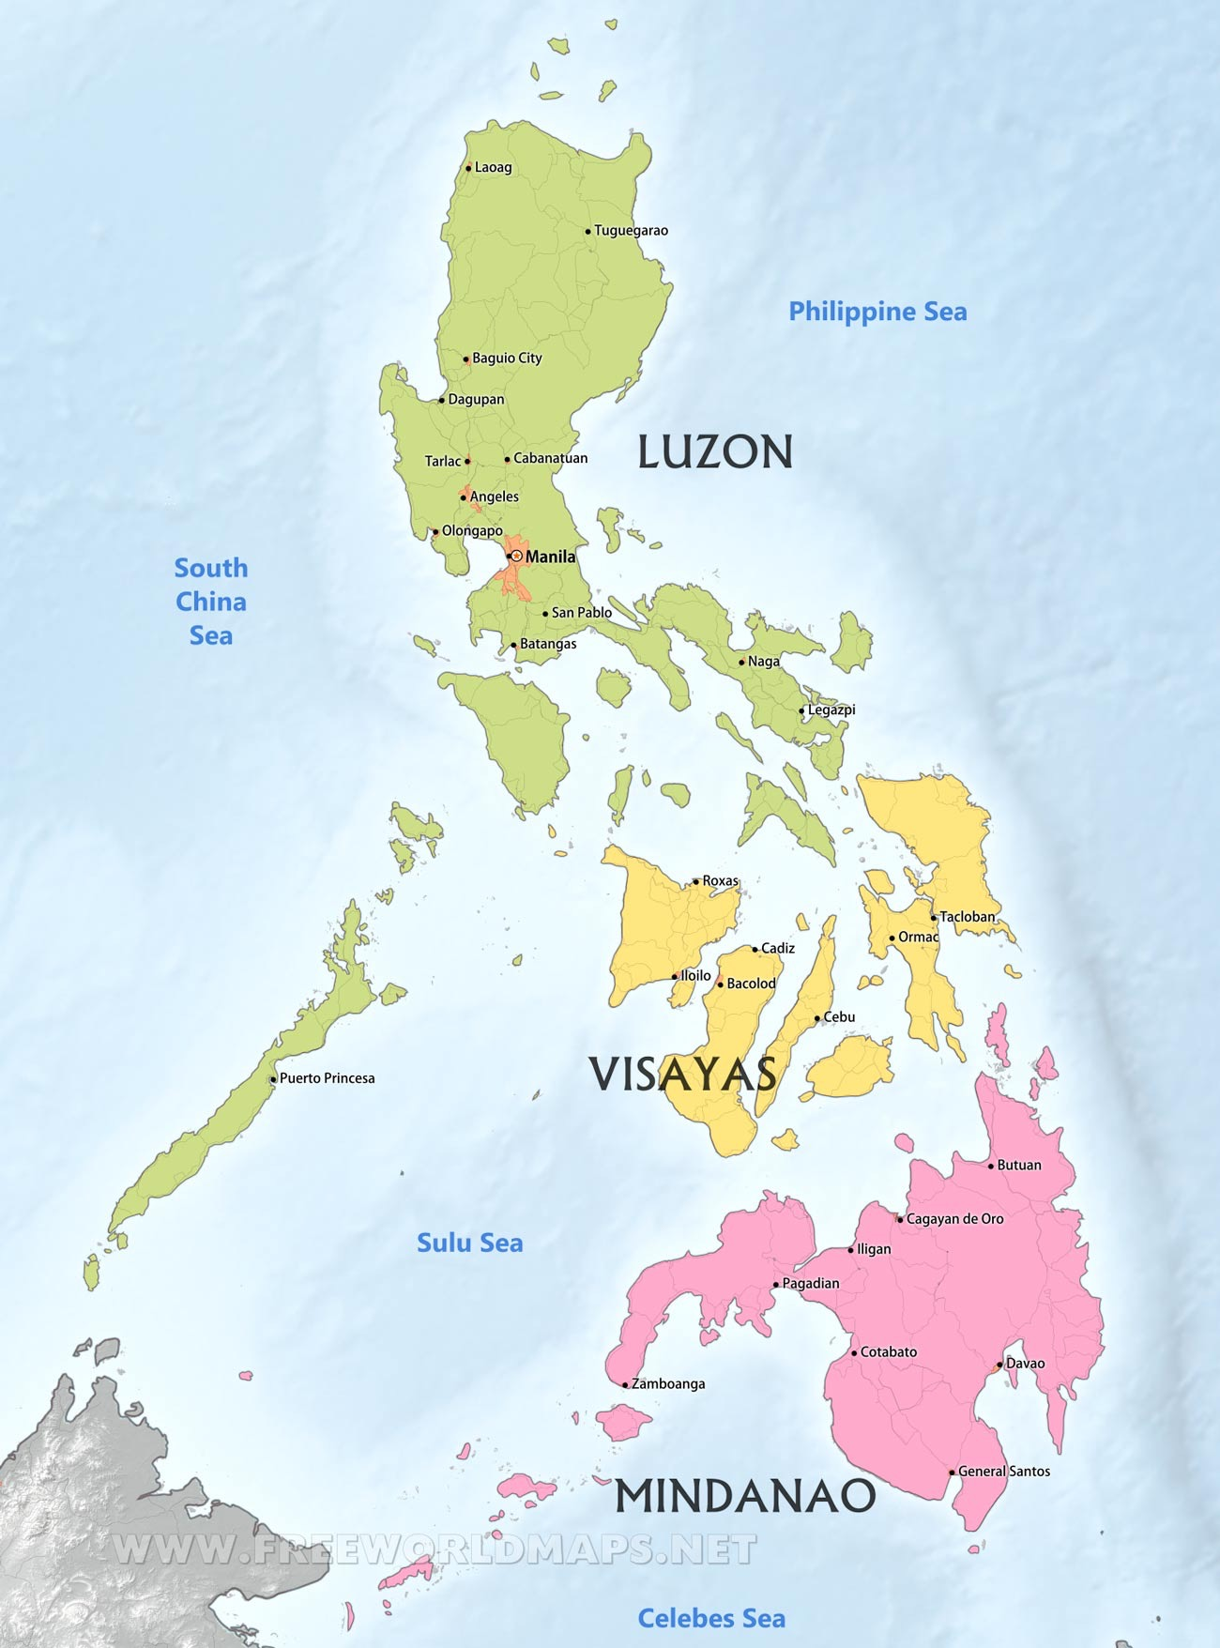
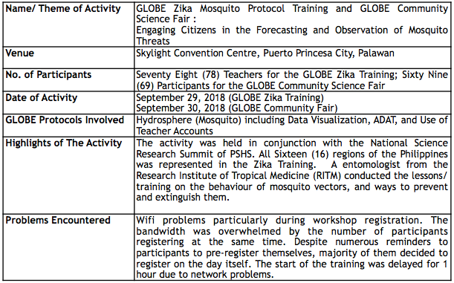
Puerto Princesa, Palawan

Slide 9
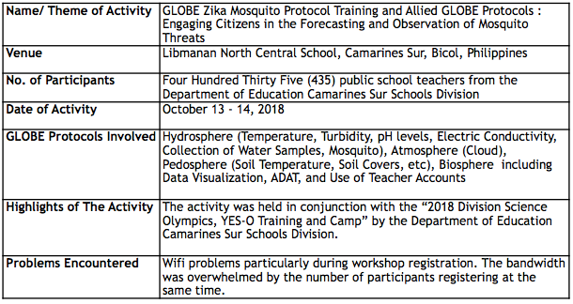
Libmanan, Bicol Province

Slide 10
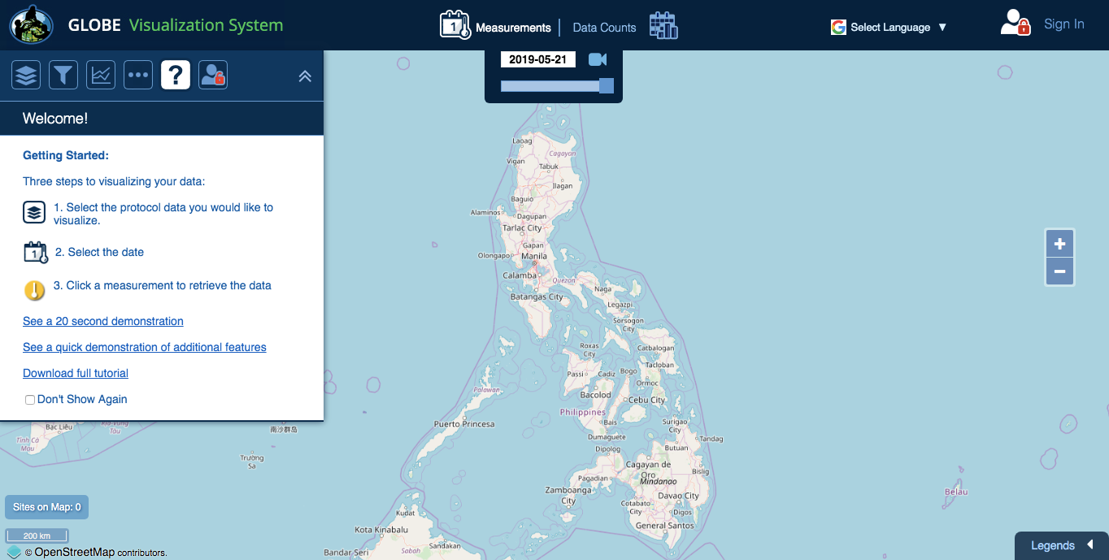
The GLOBE Zika Project was featured at the Philippine Smart City Summit of 2018, attended by local and foreign delegates, and was introduced as part of the city’s anti-dengue drive

Slide 11
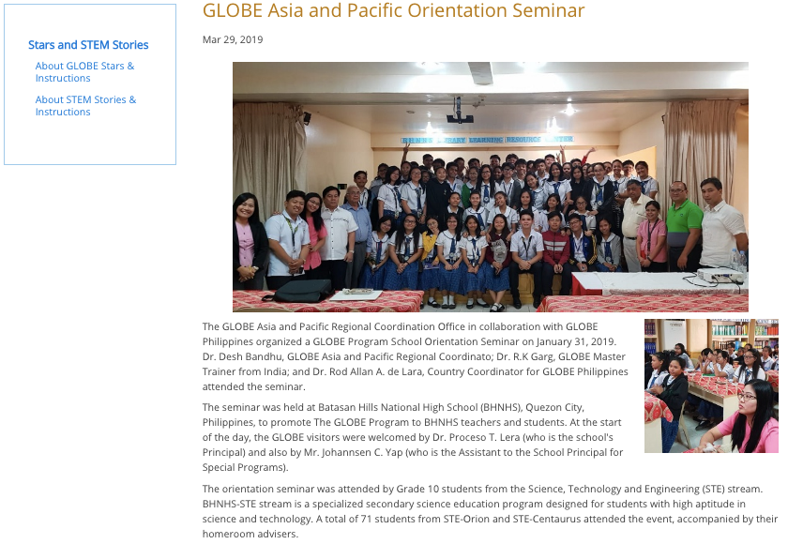
GLOBE Program Orientation,
January 31, 2019
Batasan Hills National High School

Slide 12
Local Mosquito Workshop (LMWs)
Four (4) LMWs Conducted in Barangay Batasan Hills, Quezon City (March 13 - 15, 2019):
Sixty Four (64) participants
At least 320 unique data generated
Grant Winner, IVSS (June 2019)

Slide 13
Participation in GLOBE Regional Events/Activities
Participation in GLOBE Asia Pacific Region Country Coordinator’s Meeting, Hanoi, Vietnam, May 6 - 9, 2018
Participation in GLOBE Zika Asia Pacific Region Training, Hanoi, Vietnam, May 10 - 11, 2018, with Three (3) teachers plus One (1) Country Coordinator
Participation in 2018 Taiwan Science Festival, July 19 - 23, 2018 Taichung, Taiwan, With Twenty-One (21) Students and 10 Teachers including observers from the Department of Education. Four (4) research posters presented, plus One (1) robotic product demonstration:
Probing the ability of carbonised Mahogany (Swietenia Macrophylla) pericarp in stabilising the level of Hydrogen Ion reaction of soil horizons from different sites in Sito Bagsak;
The regulating effect of Christella Arida D. Don on the properties of selected freshwater sites at Barangay Batasan Hills;
Risk mapping of mosquitoes borne diseases in Batasan Hills, Quezon City;
Riparian zone analysis, macroinvertibrates biodiversity and water quality analysis of selected streams in Cabadbadan Agusan del Norte, Philippines;
Participation in 2018 Korea Science Festival thru GLOBE Korea and the Korea Foundation for the Advancement of Science and Creativity, August 9 - 12,
Participation in editing and translating the Zika Zine in Filipino with Emily Snode-Brenneman

Slide 14
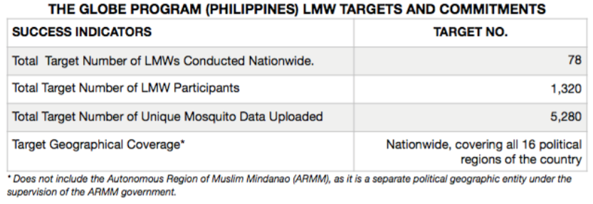
2019 Planned Activities
Nationwide Implementation of LMW

Slide 15
2019 Planned Activities
2. NASA Airborne Science Team : 2019 CAMP2Ex (Cloud, Aerosol and Monsoon Processes Philippines Experiment) mission. September 12 - 13, 2019 at the Philippine Science High School Main Campus, Diliman, Quezon City; and Batasan Hills National High School, Barangay Batasan, Quezon City. September 14, 2019 at the Philippine Science High School Clark Campus, Pampanga City
3. 2019 GLOBE Science Fair, October 2019, in collaboration with the PSHS System, Batasan Hills National High School, and the Quezon City Science Community Foundation Inc.
Launching of GLOBE Program in Nabua National High School, Camarines Sur and GOA National High School, Albay (Bicol Province)

Slide 16
Challenges and Problems Encountered
Funding and Lack of Resources
Network/ Internet Problems
LMW Training/ Seminar cannot be registered in the System
Web Content Development & Social Media Networking, needs improvement

Slide 17
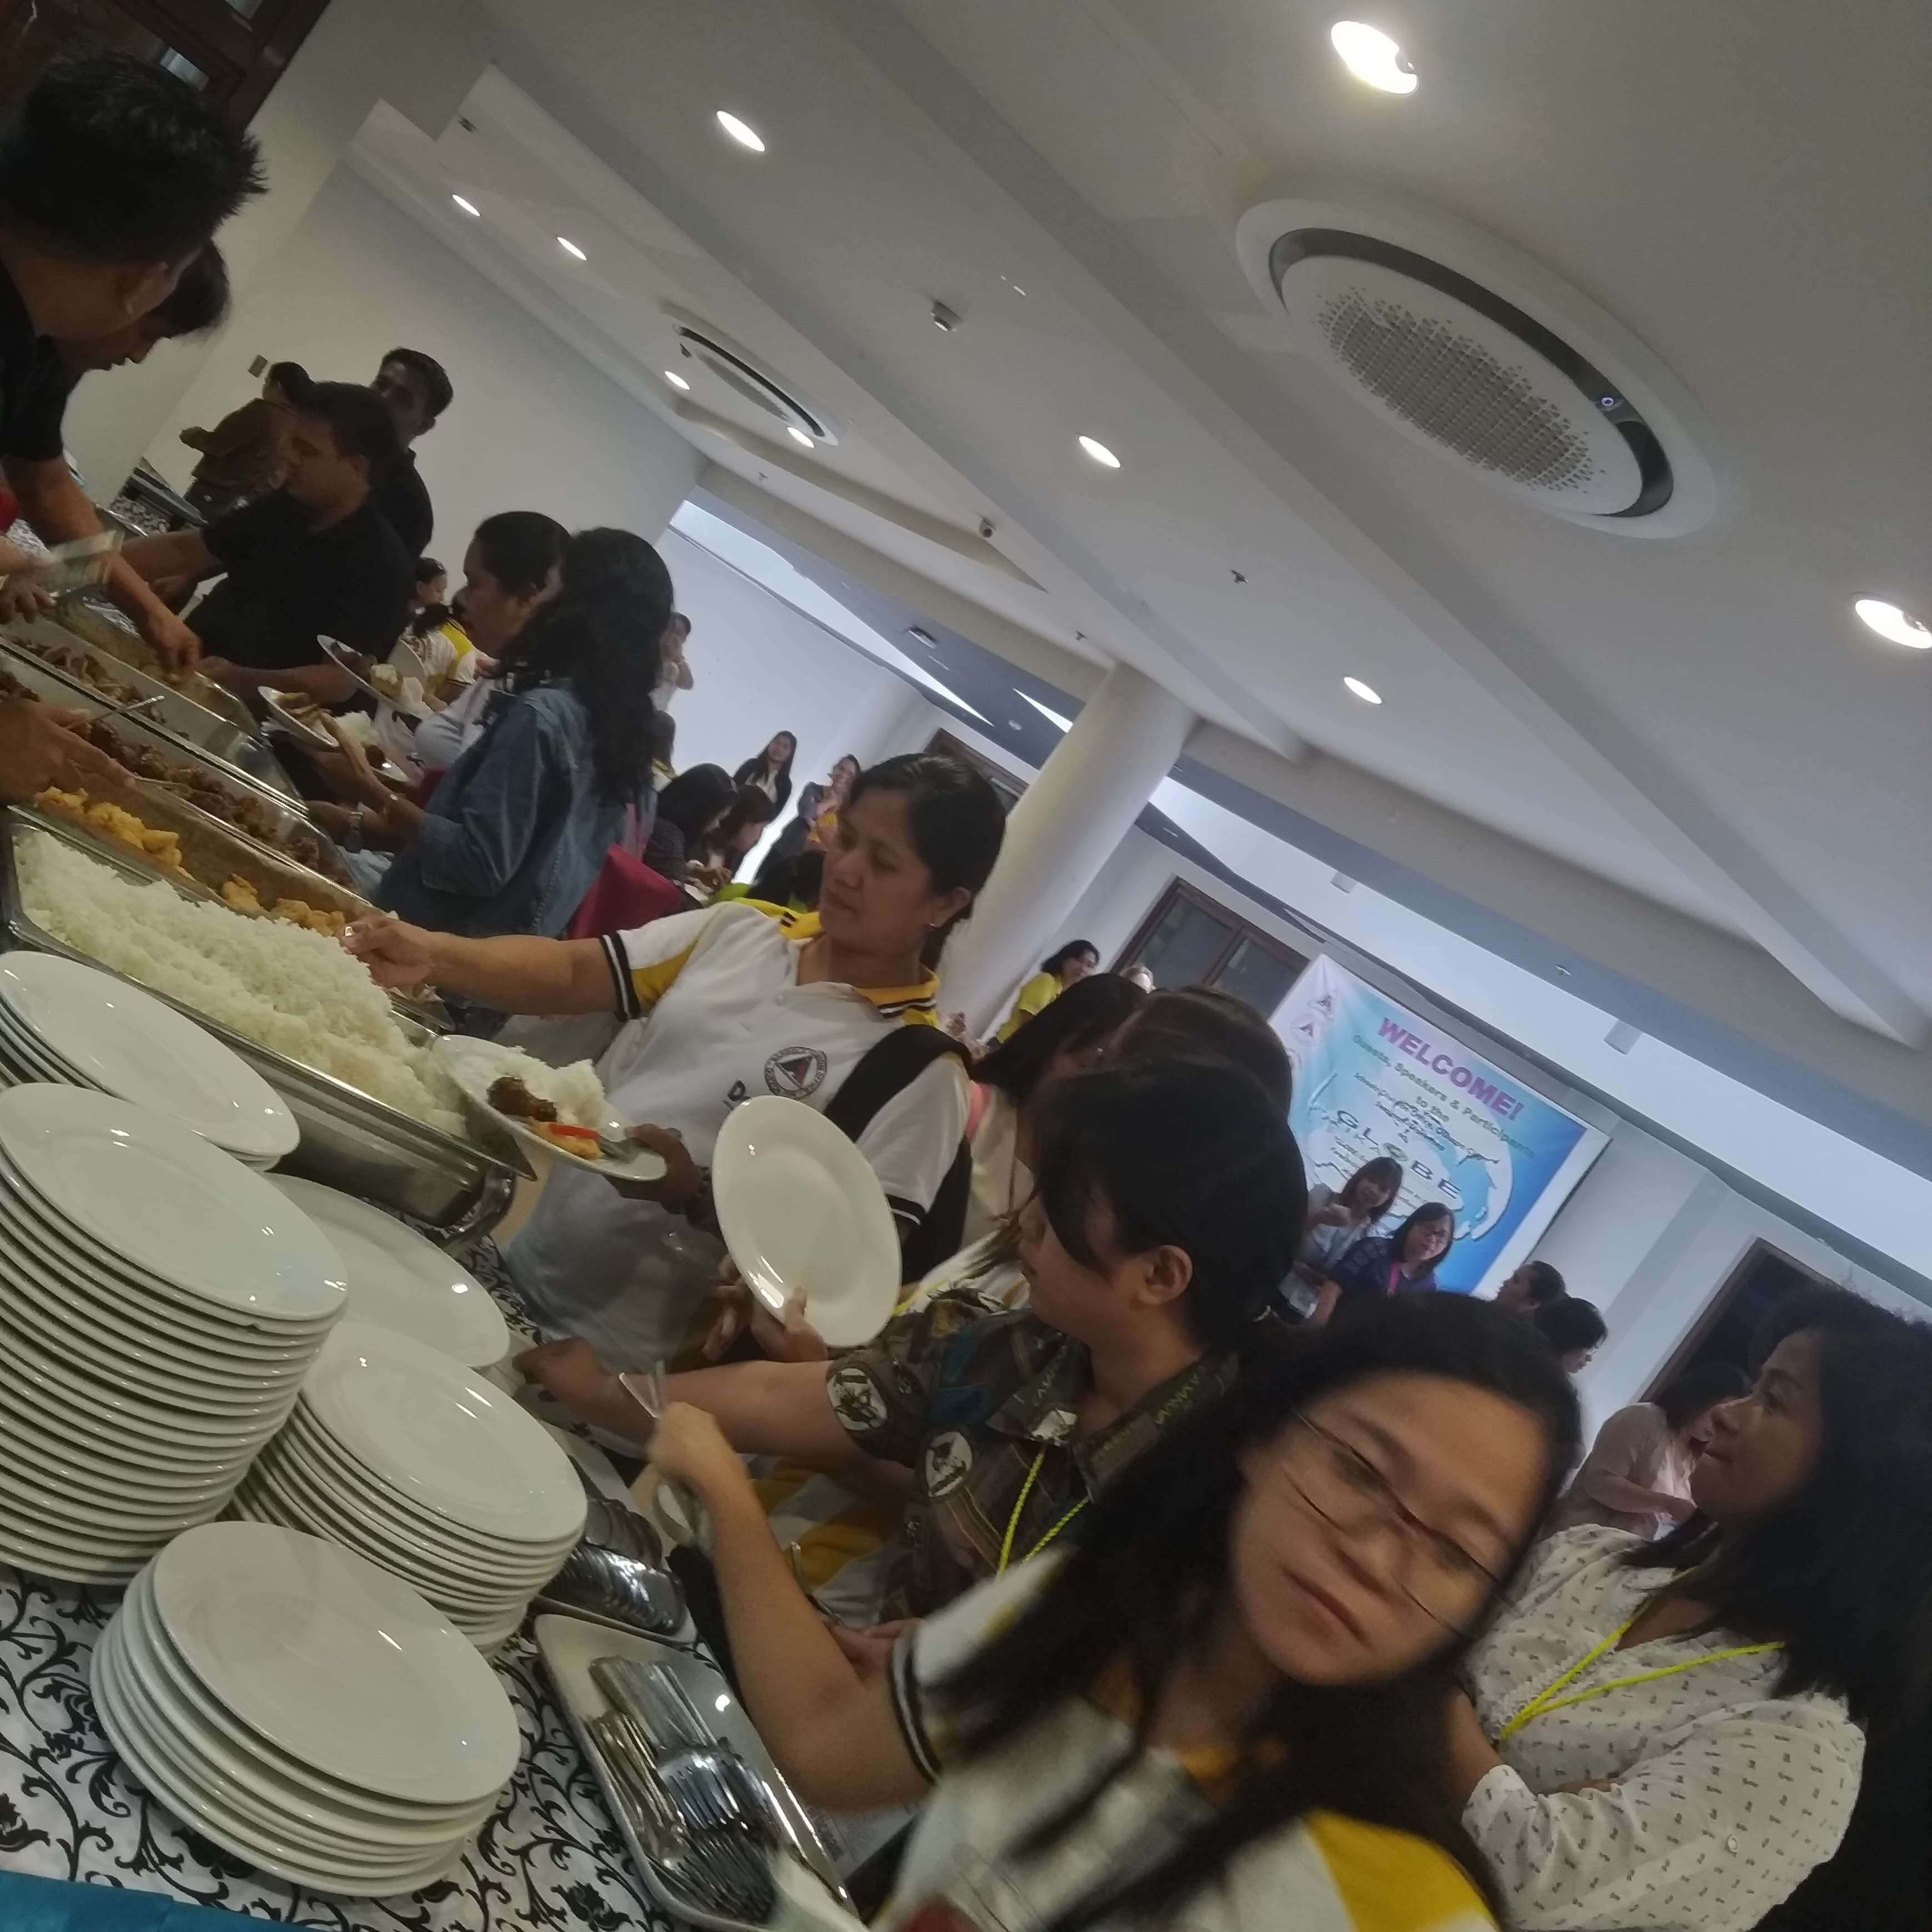
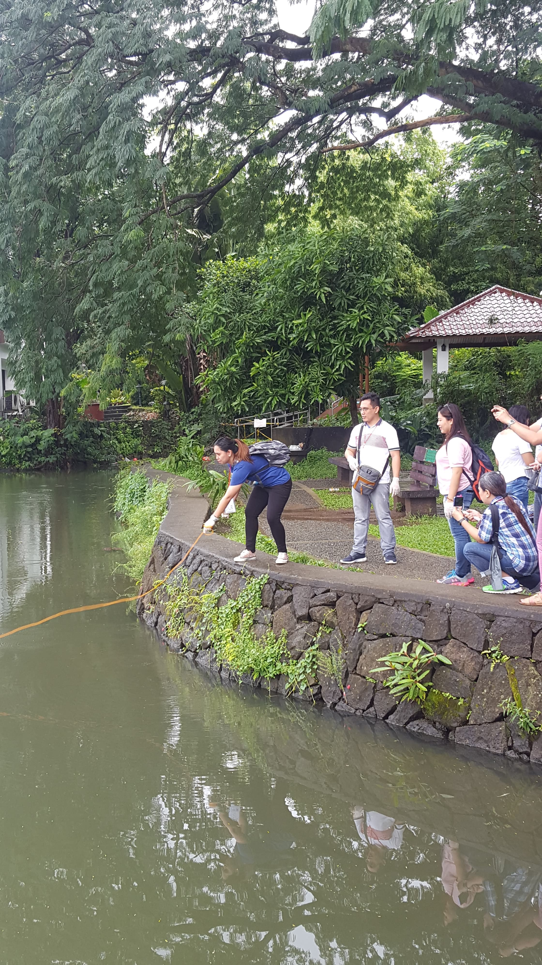

Slide 18
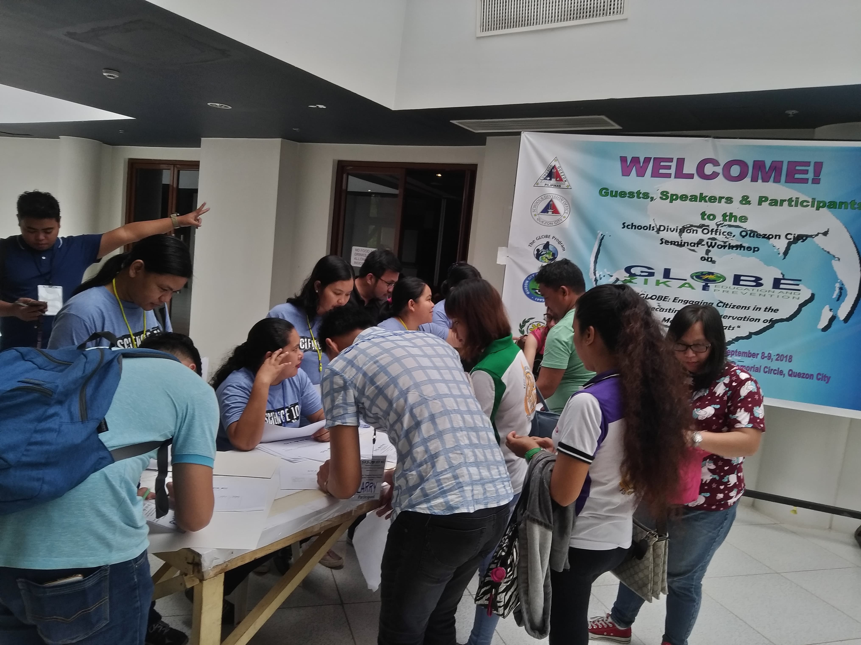
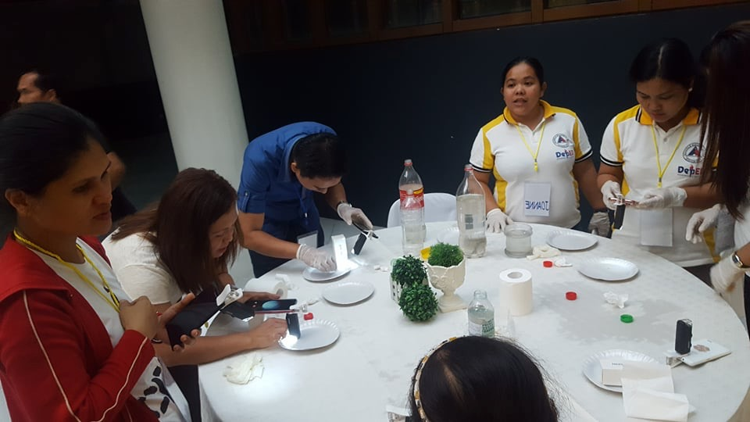
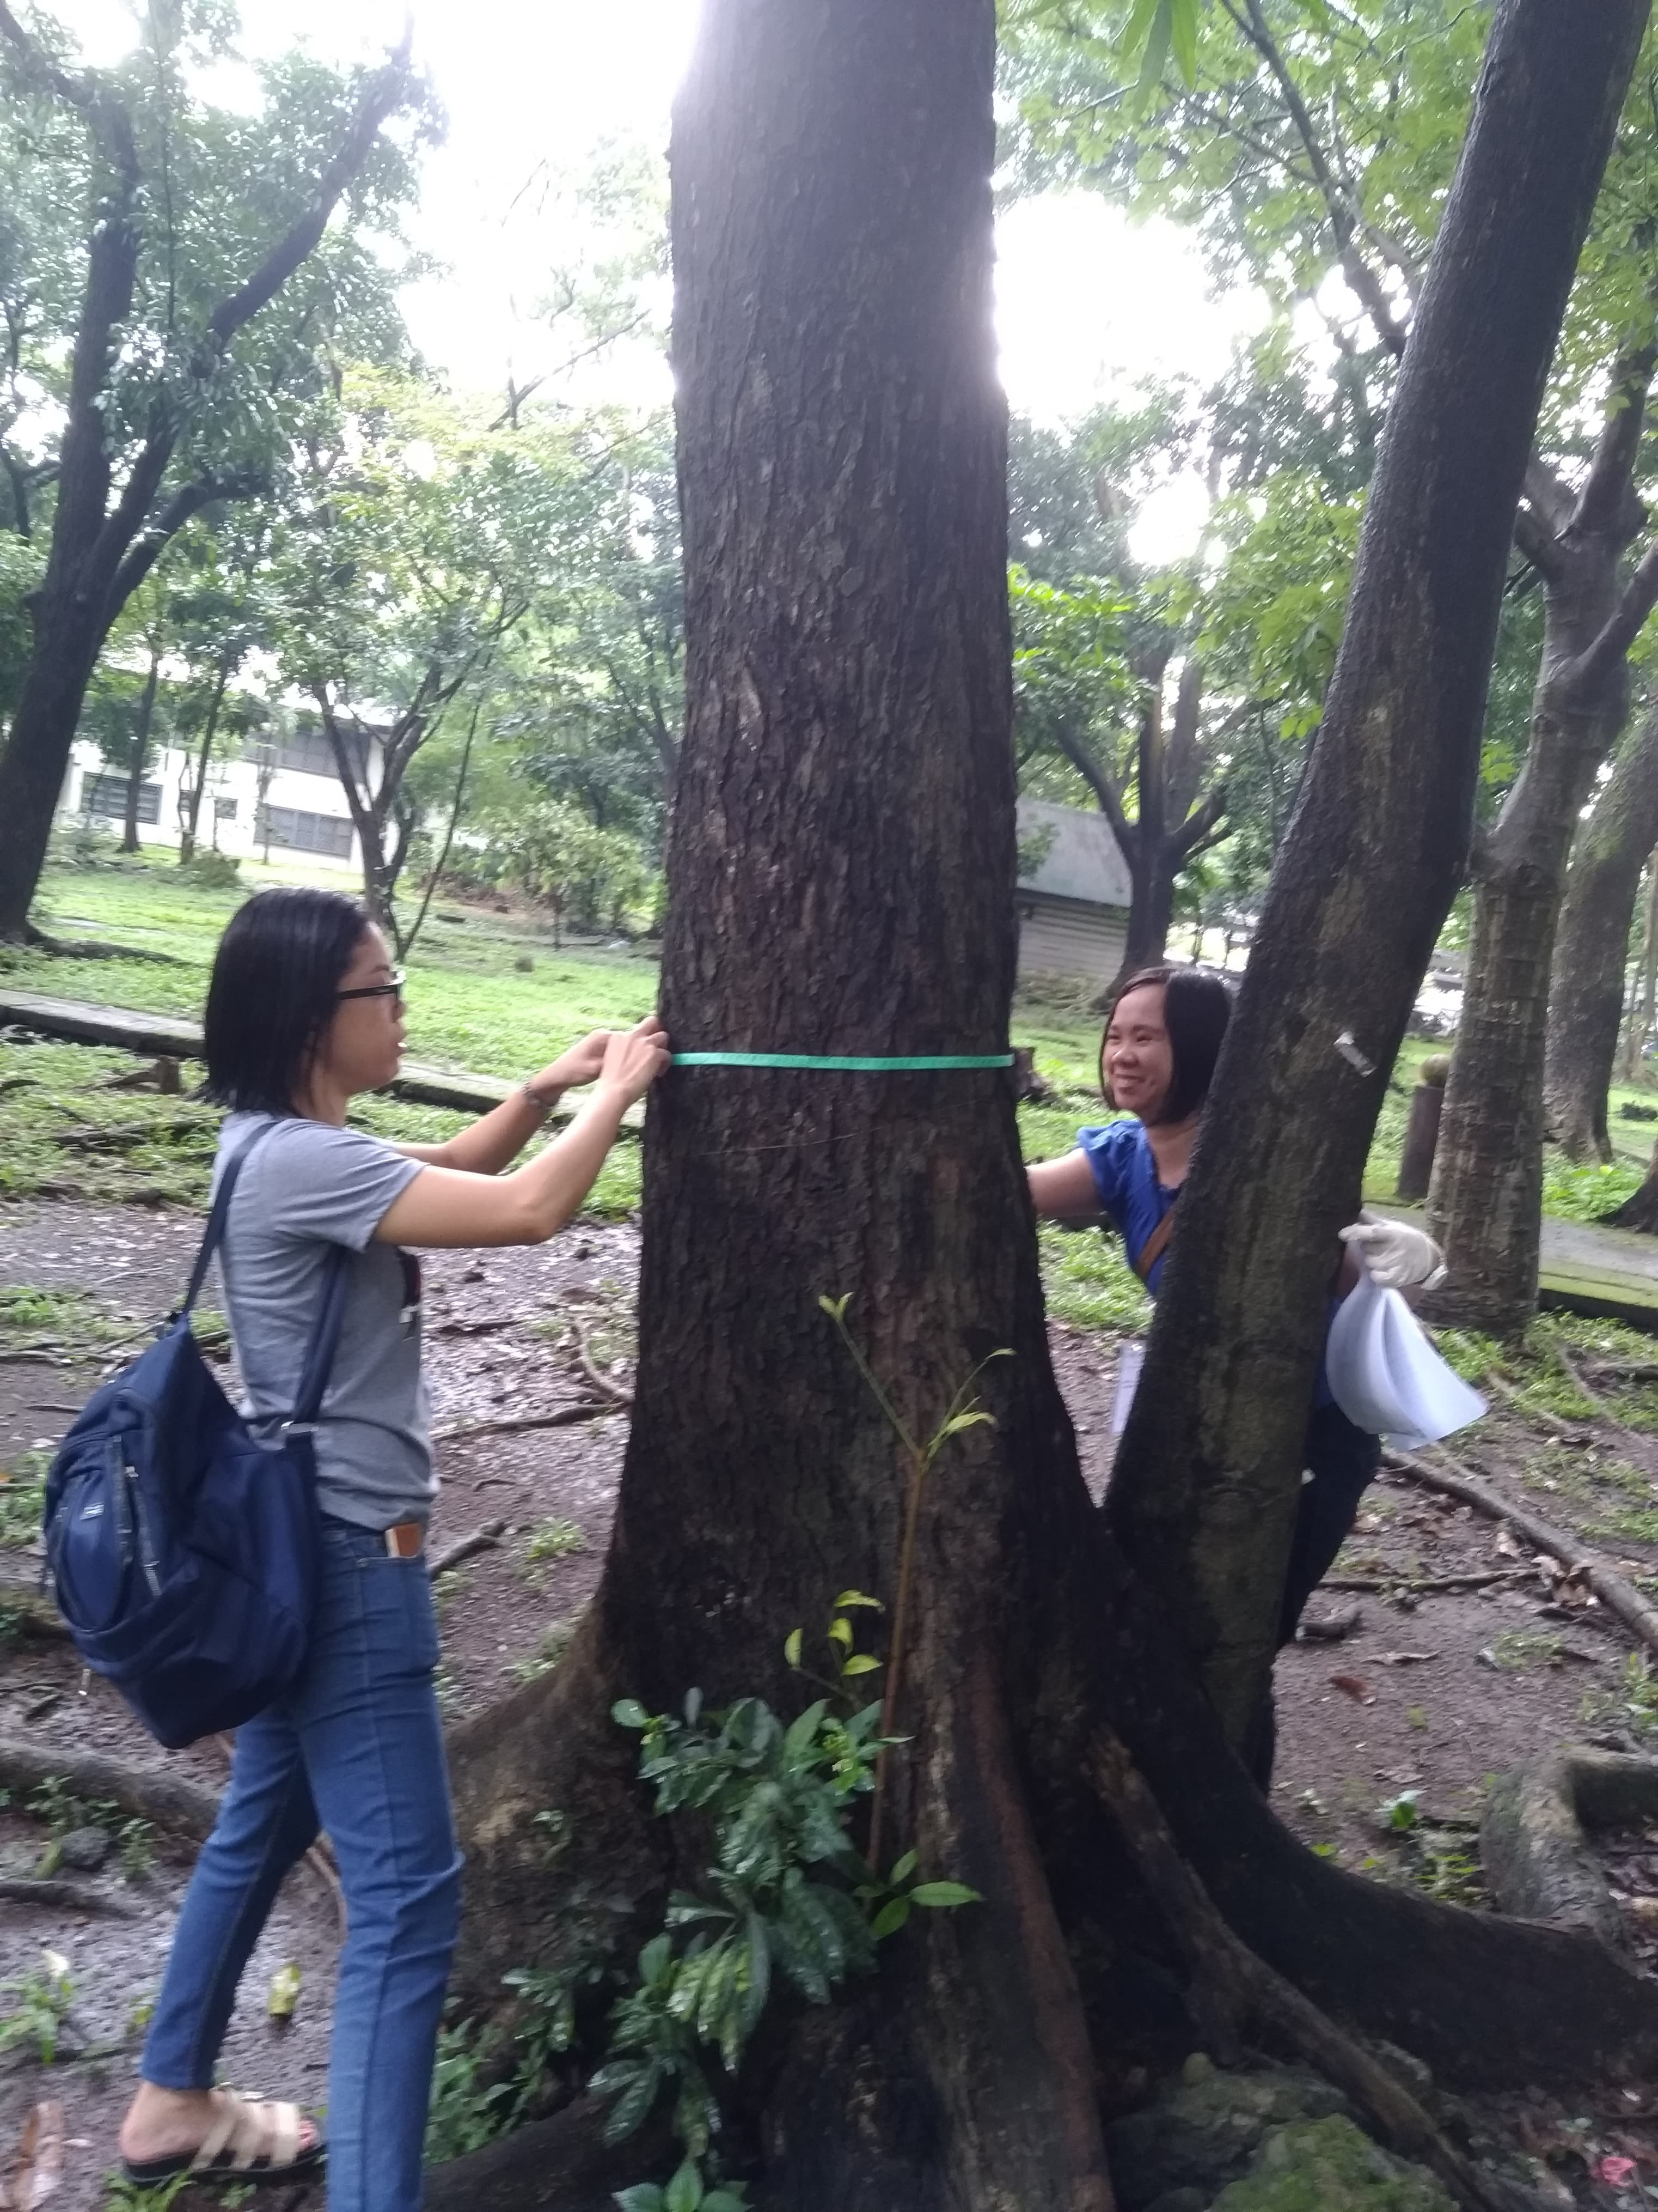

Slide 19
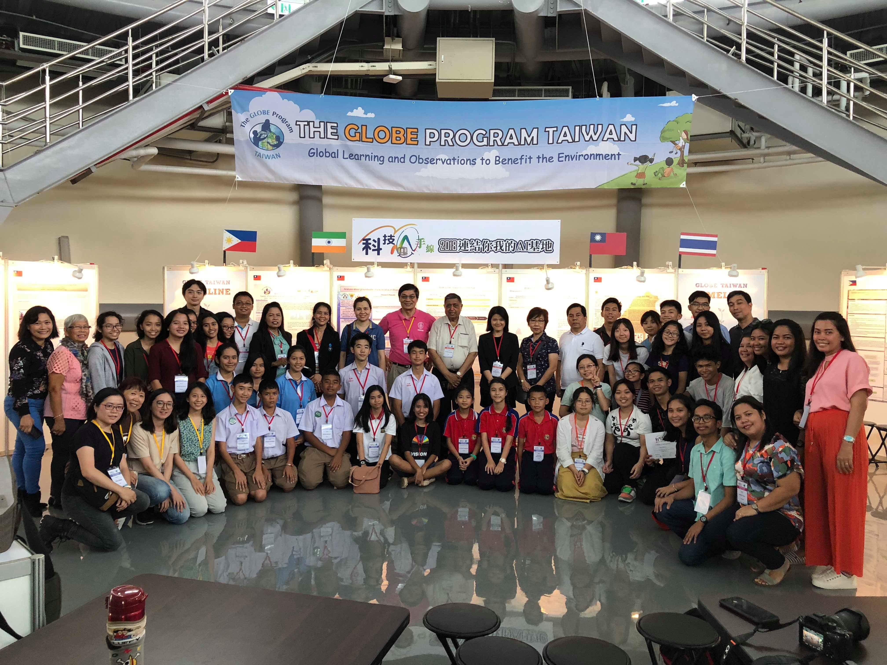
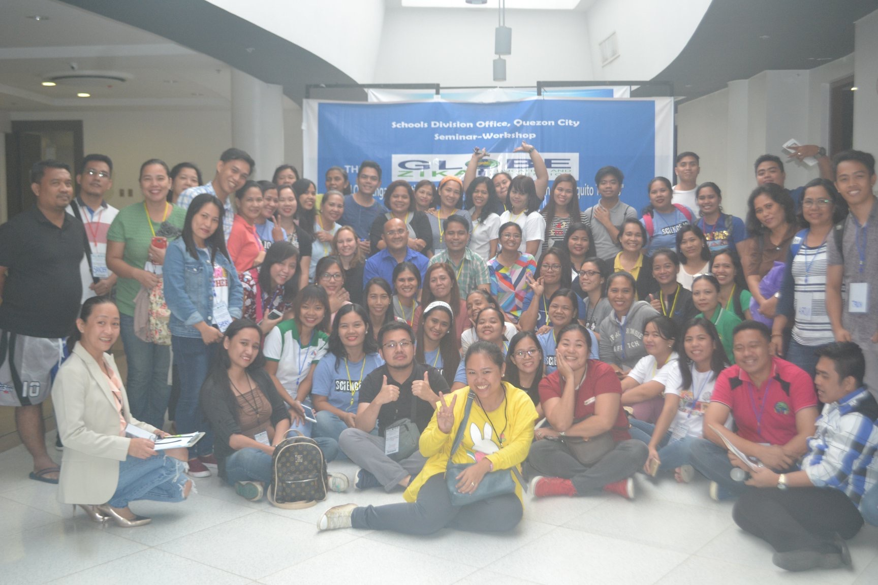
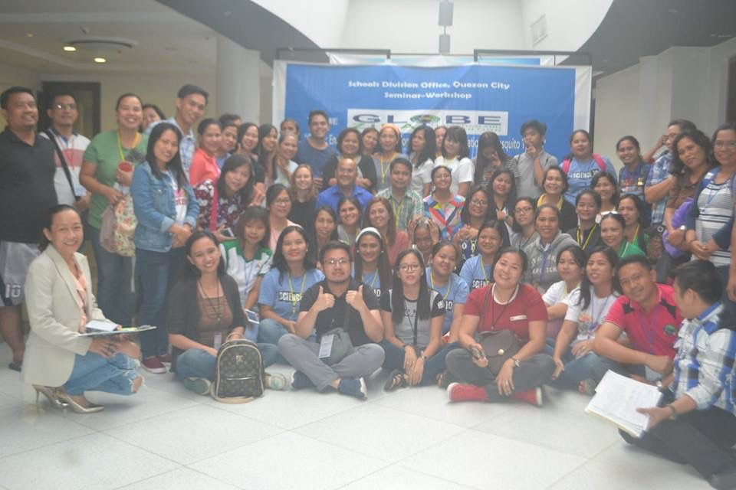
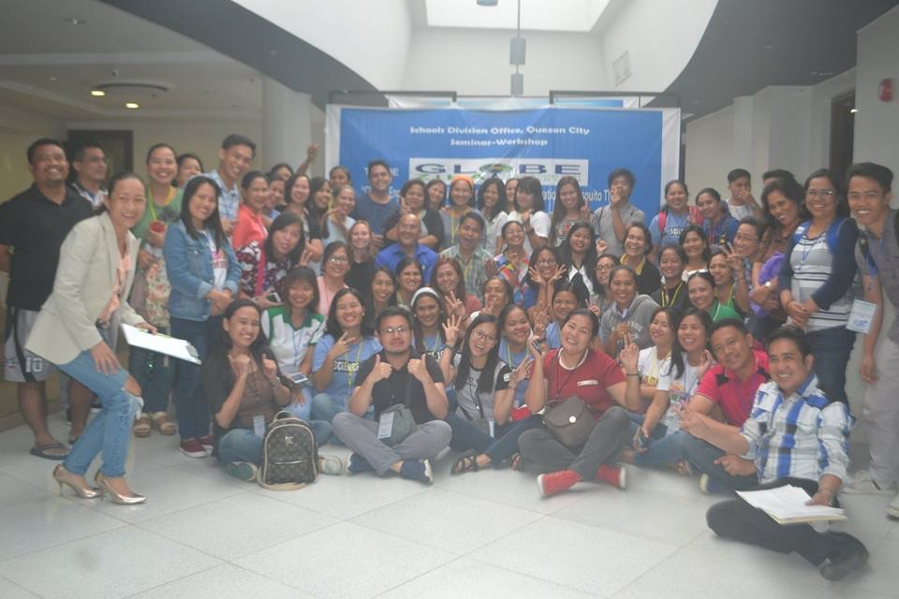

Slide 20
